Slide 1

Elastic Load Balancer

Slide 2
Introduction
Elastic Load Balancing automatically distributes your incoming traffic across multiple targets, such as EC2 instances, containers, and IP addresses, in one or more Availability Zones.
It monitors the health of its registered targets, and routes traffic only to the healthy targets.
Elastic Load Balancing scales your load balancer as your incoming traffic changes over time.
It can automatically scale to the vast majority of workloads.
Works in round robin

Slide 3
Features
Security :It uses Amazon Private Virtual Network Cloud thus providing extra security to the load balancers and one can even create an internal load balancer.
Health checks :It can track unfit targets and prohibits the flow of load towards and then balances the load towards the working targets.
High availability :It can automatically distribute traffic to multiple availability zones or single availability zone working on the same load balancer.
Operational Monitoring: With Amazon CloudWatch metrics, logging and request tracking, one can overview the working in real-time.
Layer 4 and Layer 7 balancing: HTTP/HTTPS applications can be used to load balance for 7 Layer or strictly for layer 4 which depends on UDP and TCP controls.

Slide 4
Listener
A listener is a process that checks for connection requests, using the protocol and port that you configure.
The rules that you define for a listener determine how the load balancer routes requests to its registered targets.
Protocols : HTTP, HTTPS, TCP, UDP
Ports :1-65535
Target Groups
Target group is used to route requests to one or more registered targets.
Internet- Facing
An internet-facing load balancer has a publicly resolvable DNS name, so it can route requests from clients over the internet to the EC2 instances that are registered with the load balancer.

Slide 5
Monitor
We can monitor load balancer through
CloudWatch metrics
Elastic Load Balancing access logs: Provide detailed information on each request processed by the load balancer
CloudTrail logs
Rule
A rule is made up of conditions and actions for routing requests. The actions are taken when the conditions on the rule are matched. Currently, ALB only supports condition of path and action of forward
Health Check
Load Balancer periodically sends requests to its registered instances to test their status. These tests are called health checks.

Slide 6
Field | Description
Protocol | The protocol to use to connect with the instance. Valid values: TCP, HTTP, HTTPS, and SSL Console default: HTTP CLI/API default: TCP
Port | The port to use to connect with the instance, as a protocol: port pair. If the load balancer fails to connect with the instance at the specified port within the configured response timeout period, the instance is considered unhealthy. Protocols: TCP, HTTP, HTTPS, and SSL Port range: 1 to 65535 Console default: HTTP:80 CLI/API default: TCP:80
Path | The destination for the HTTP or HTTPS request. An HTTP or HTTPS GET request is issued to the instance on the port and the path. If the load balancer receives any response other than "200 OK" within the response timeout period, the instance is considered unhealthy. If the response includes a body, your application must either set the Content-Length header to a value greater than or equal to zero, or specify Transfer-Encoding with a value set to 'chunked'. Default: /index.html
Response Timeout | The amount of time to wait when receiving a response from the health check, in seconds. Valid values: 2 to 60 Default: 5
Health Check Interval | The amount of time between health checks of an individual instance, in seconds. Valid values: 5 to 300 Default: 30
Unhealthy Threshold | The number of consecutive failed health checks that must occur before declaring an EC2 instance unhealthy. Valid values: 2 to 10 Default: 2
Healthy Threshold | The number of consecutive successful health checks that must occur before declaring an EC2 instance healthy. Valid values: 2 to 10 Default: 10

Slide 7
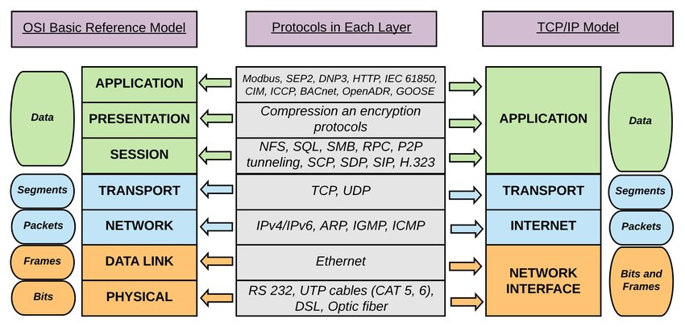
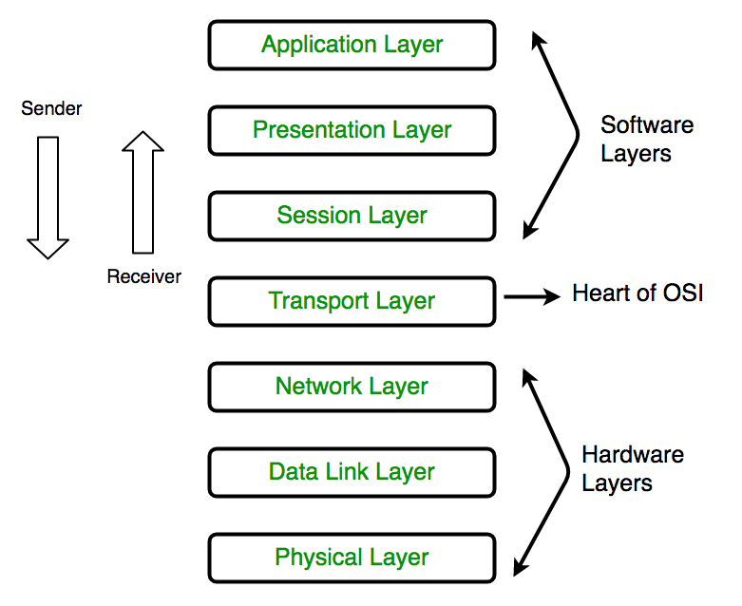
Types Of Load Balancer
Application LB- Route layer 7 traffic
Network LB- Route layer 4 traffic
OSI Model

Slide 8
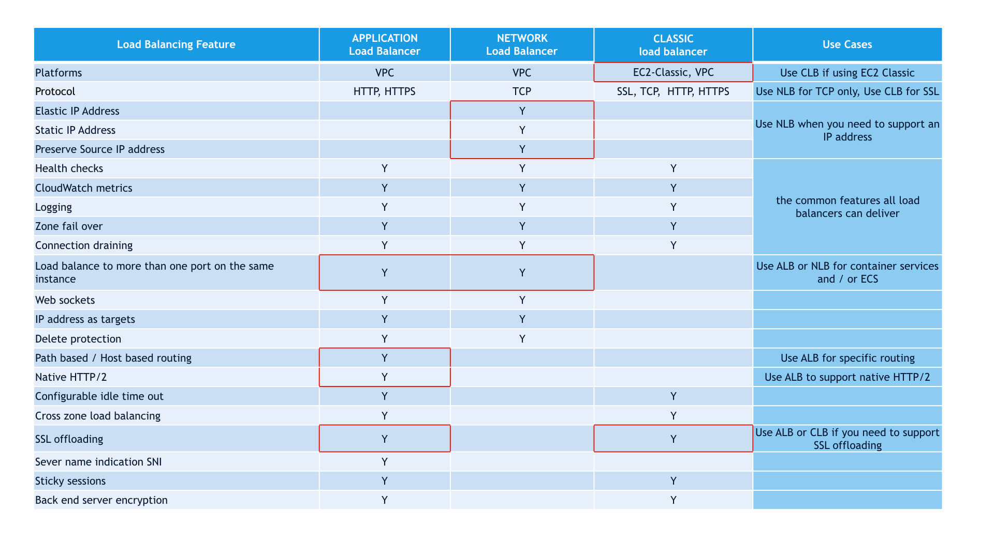

Slide 9
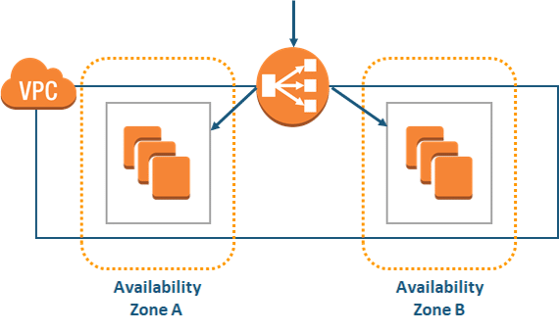
Lab
DNS
EC2
EC2

Slide 10
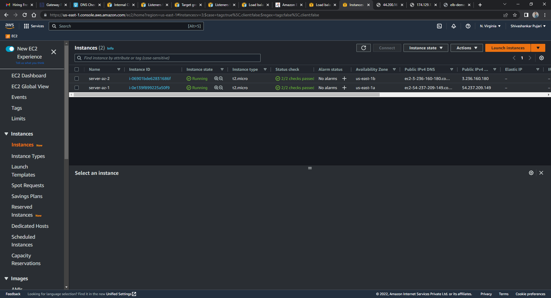
1. Launched two EC2 in diff AZ, installed web sever in it having index.html file

Slide 11
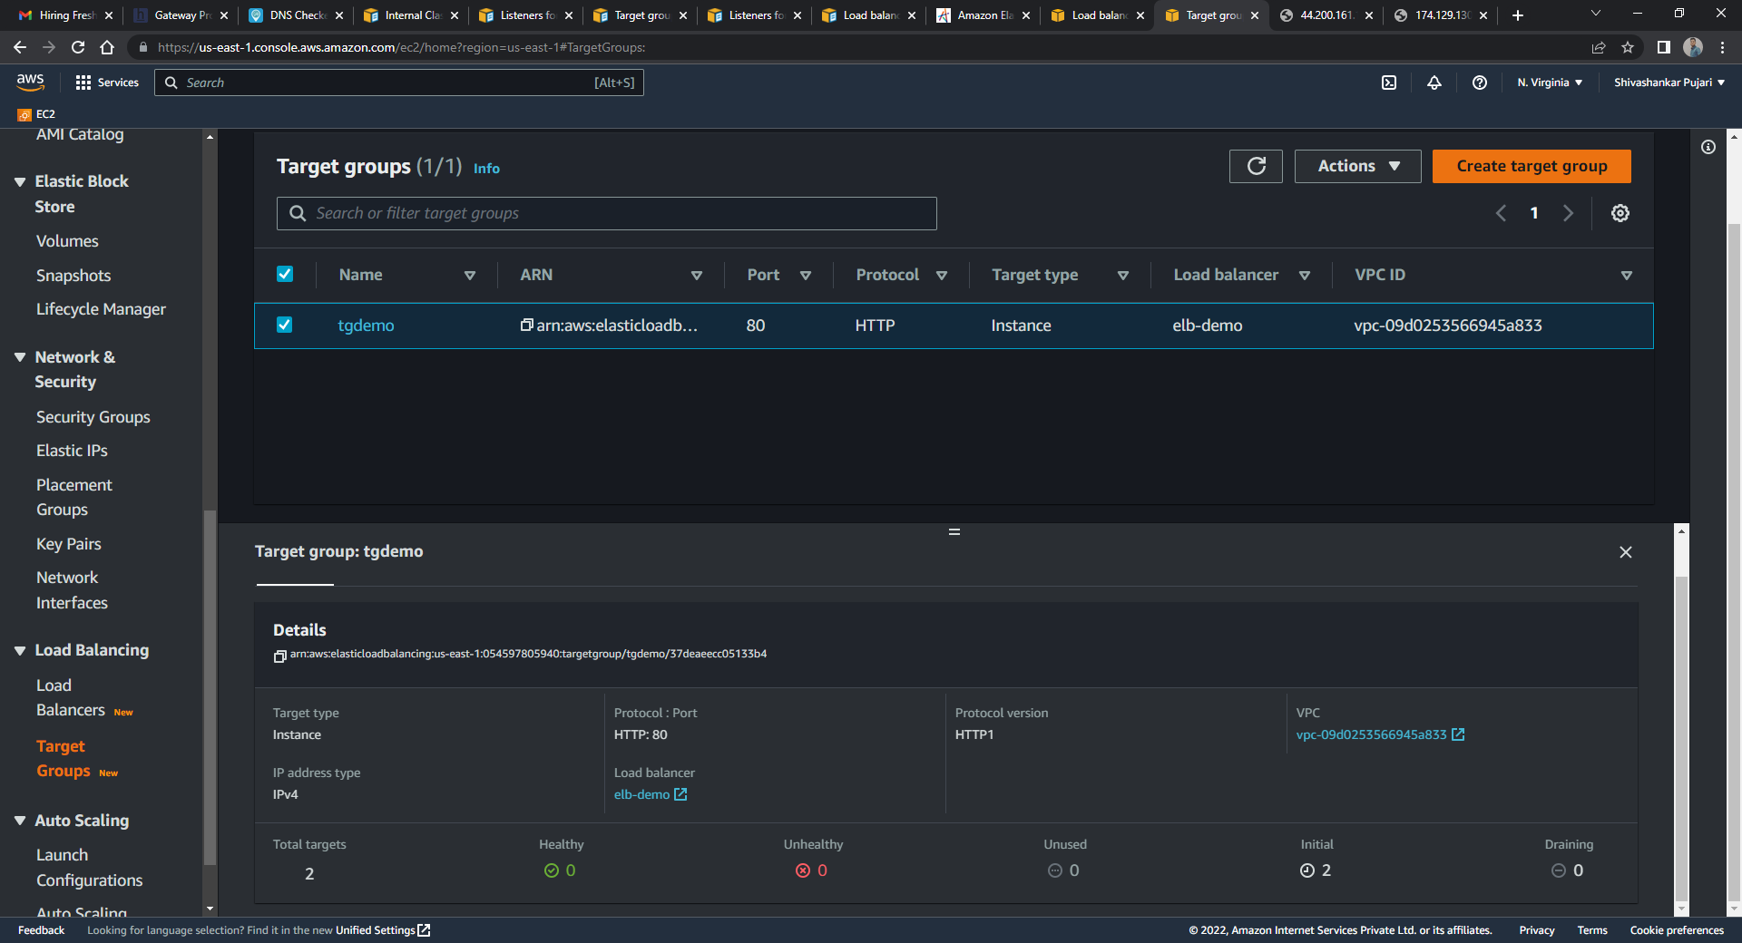
2. ELB configuration, Target groups

Slide 12
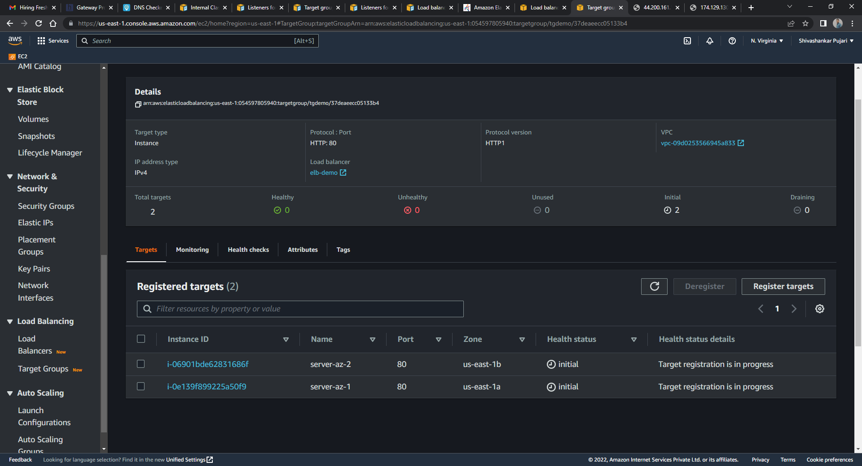
3. Initial and Unhealthy state

Slide 13
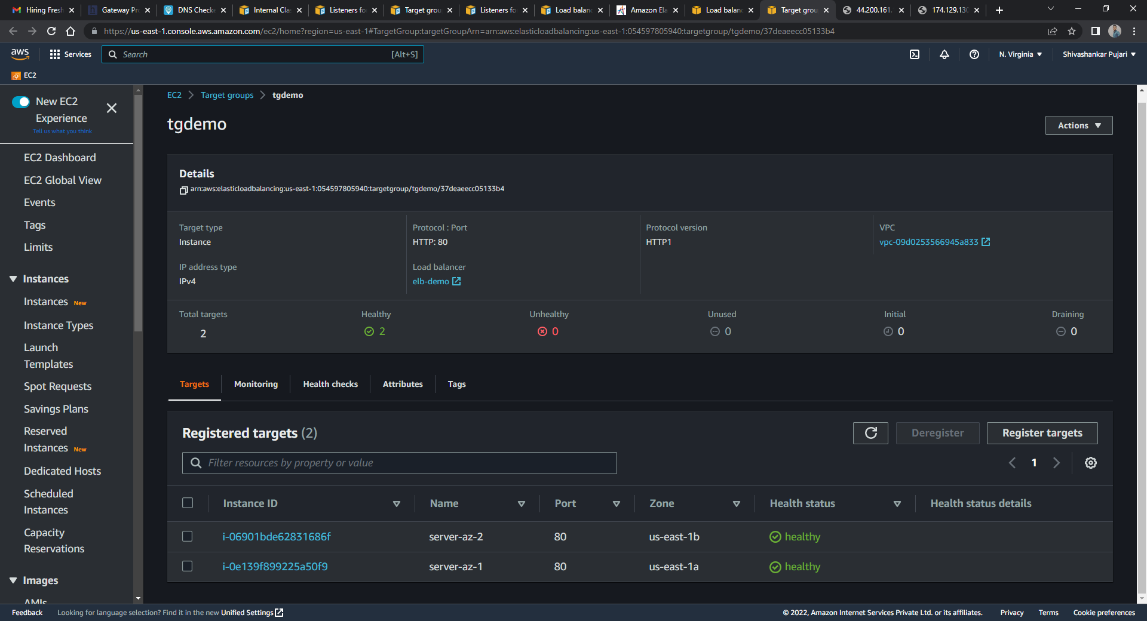
4. Healthy state

Slide 14
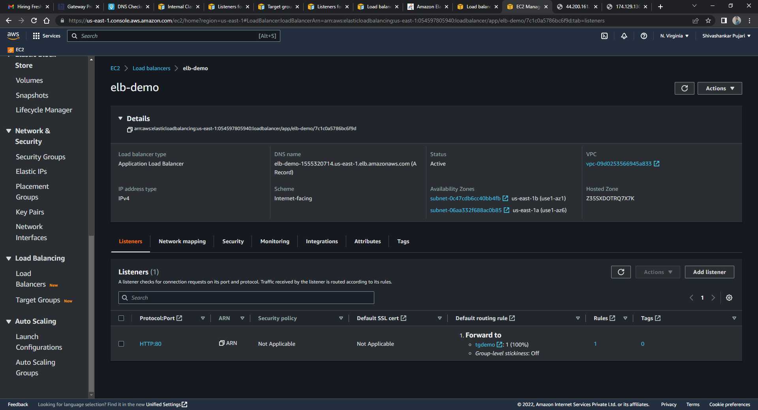
5. ELB DEMO created, copy DNS to Check how it balance to both EC2

Slide 15



